Slide 1



Project Title: Fixed Assets Operations and Reporting in Oracle ERP

Slide 2
Track: Oracle Digital Accounting Specialist
Group Code: NEXT45_CA1_ERP1_M2d

Slide 3
Team Members:
1. Mayar Abdalmoneim Alsayed Alaidy.
2. Menna Tallah Atef Mahmud Mahmoud.
3.Youstina Fawzi Kamal.
4. Nada AbdelRhem Mohamed AbdelRhem.

Slide 4
Oracle EBS Financials Modules
1-General Ledger (GL) 2-Account payable (AP)
3-Fixed Assets (FX)
4-Account Receivable (AR) 5-Cash Management (CM)

Slide 5
Objective:
To enable the user to manage the lifecycle of fixed assets, including addition, depreciation, transfers, retirement, and perform period closing tasks in the Fixed Assets module.

Slide 6
CONTENTS
Asset LIFE CYCLE IN ORACLE
Setup flexfield
Addition
Inquiry
Mass transactions
Retirement and reinstate:
Final Asset Report
Depreciation
Close period

Slide 7
There are three Flexfields that must be defined in the Assets Application
Asset Category Flexfield
Asset Locations Flexfield
Asset Key Flexfield

Slide 8
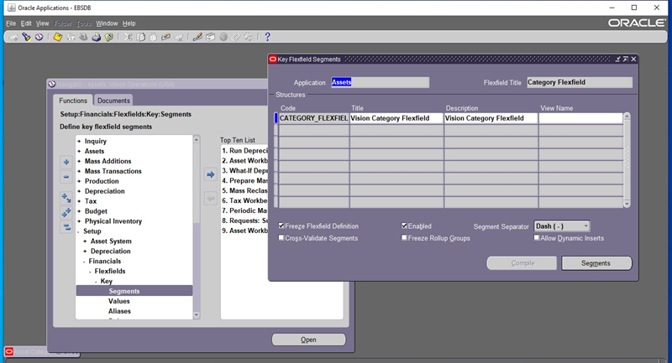
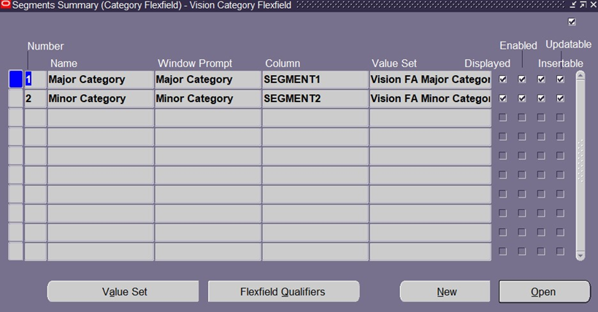
First Asset Category :
uses the category flexfield to group assets by financial information.
Setup<<Financial<<Flex field <<Key<<Segments
Segments – Value Set
Each segment of your category structure needs a value set.

Slide 9
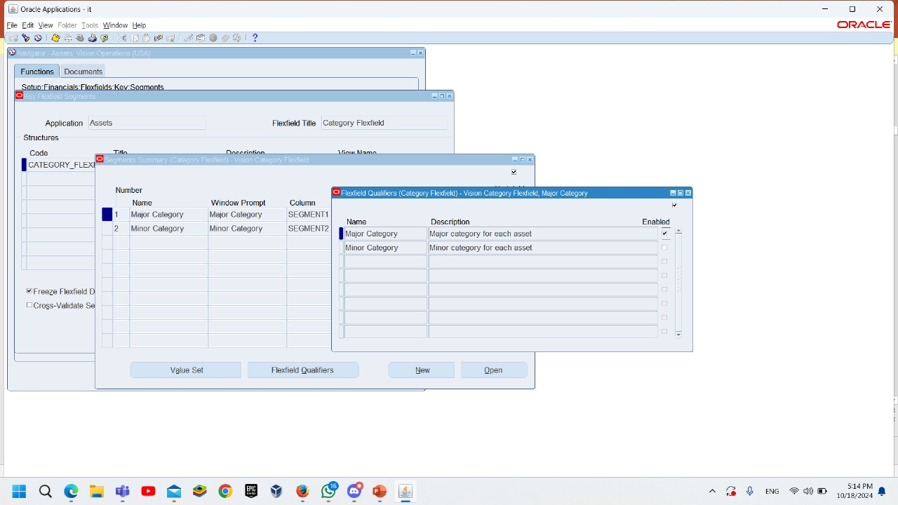
Segments – Flex field Qualifiers
Specify which segment is your major category segment by check (✓) for the Major Category qualifier in the Define Key Segments form.
Specify which segment is your Minor category segment by check (✓) for the Mainor Category qualifier in the Define Key Segments form.

Slide 10
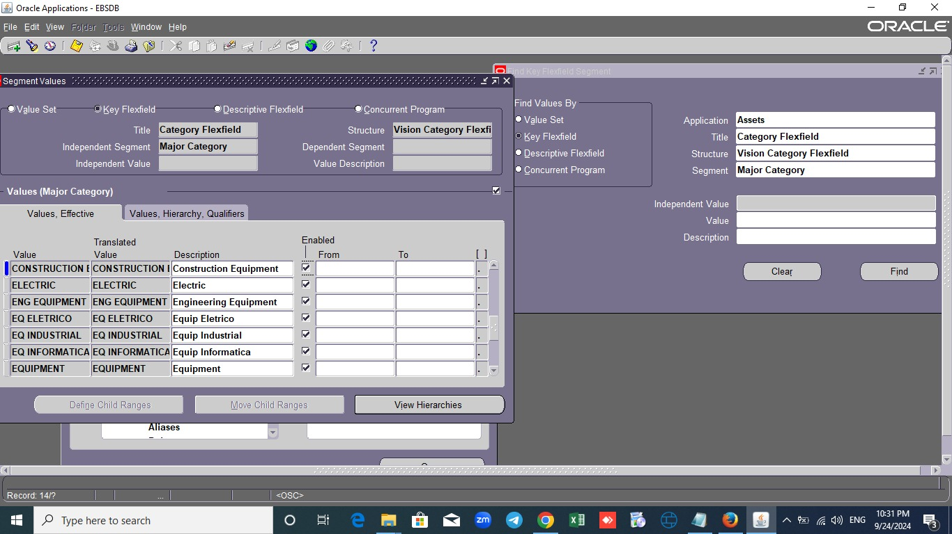
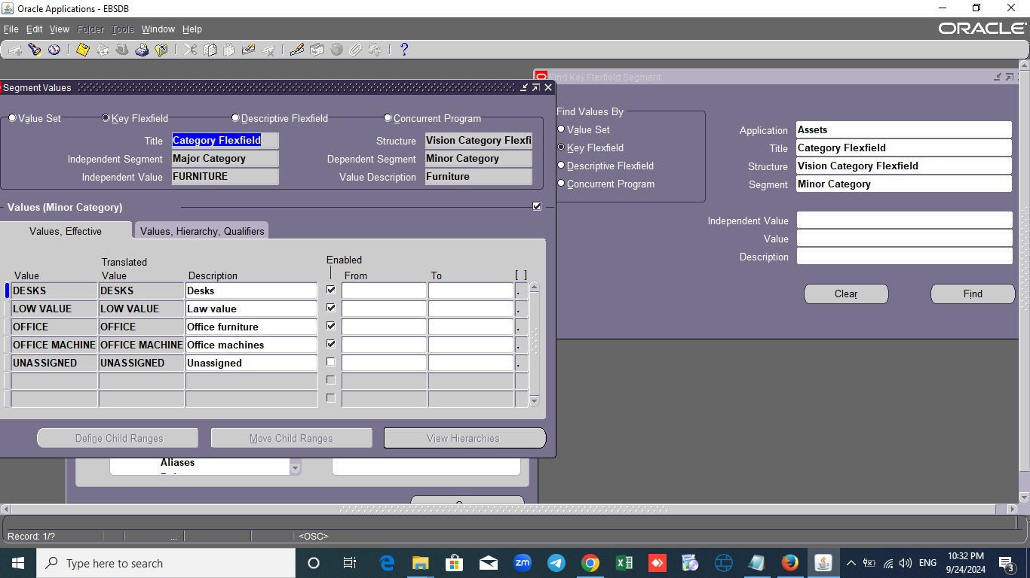
To add Category values
Setup<<Financial<<Flex field<<key<<value

Slide 11
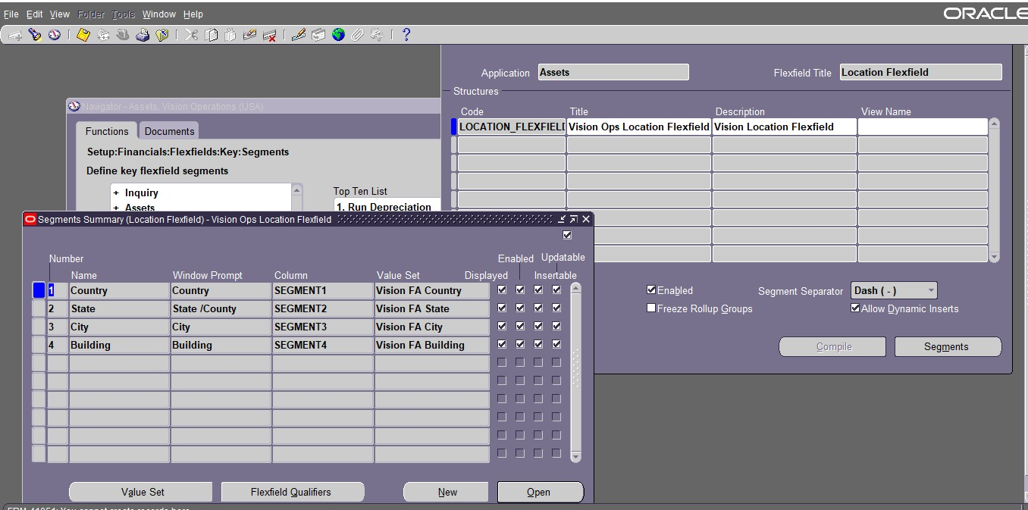
Second : Location Flexfield:
As the Asset Category Flexfield, we define location flexfield where the assets are located.
Segments are determined according to the company's requirements.
Third: Asset Key FlexField:
It represents a way in which we create
Asset more than the Category.
Each company is free to use it.

Slide 12
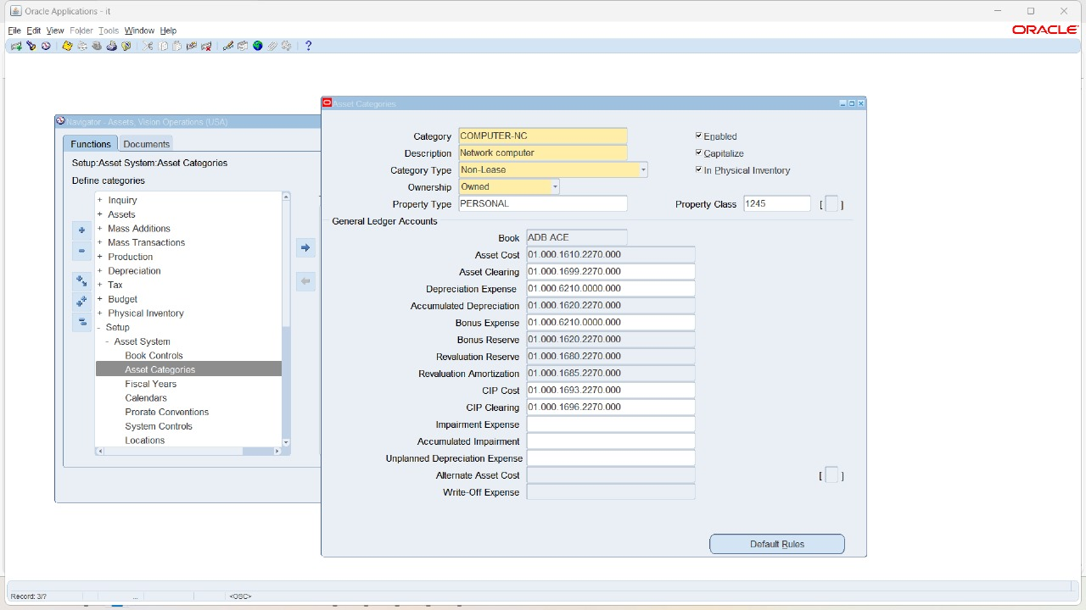
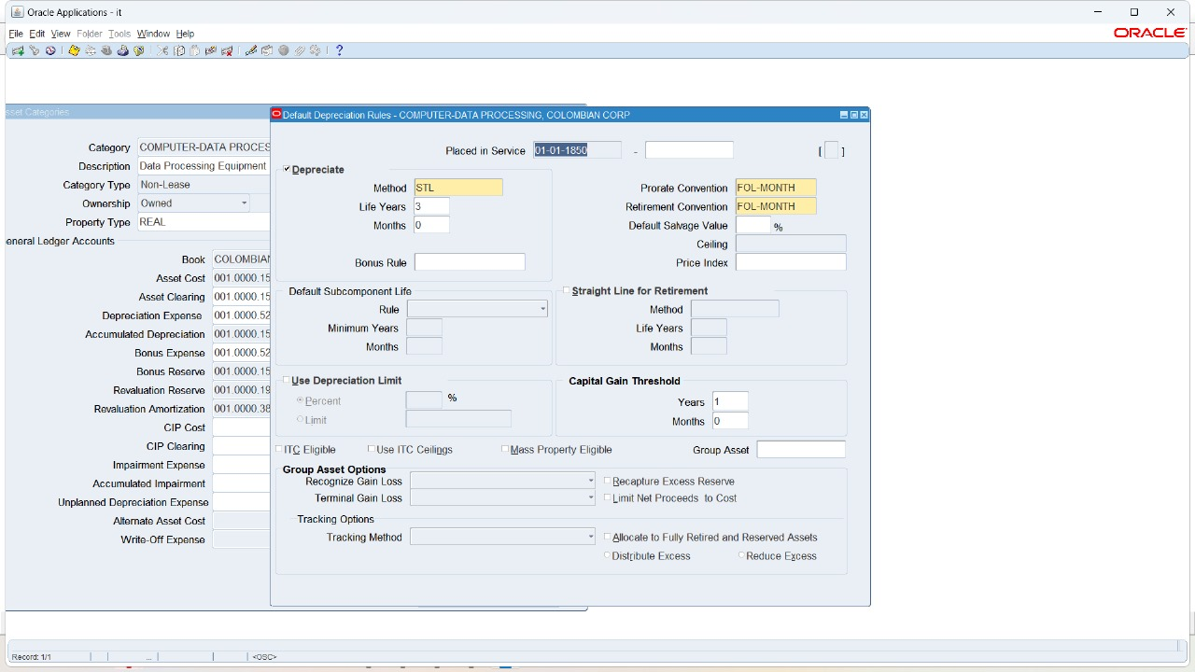
Define new asset category and find existed Asset Category Setup<<Asset System <<Asset category
Link it to the asset book and identify a group of accounts on it.
Like :
Assets cost.
Assets clearing.
Depreciation.
Accumulated deprecation.
Default rule button :
Check Depreciate box if we normally depreciate assets in this book and category.
Oracle Assets does not depreciate EXPENSED assets so we don't check the depreciate box.

Slide 13
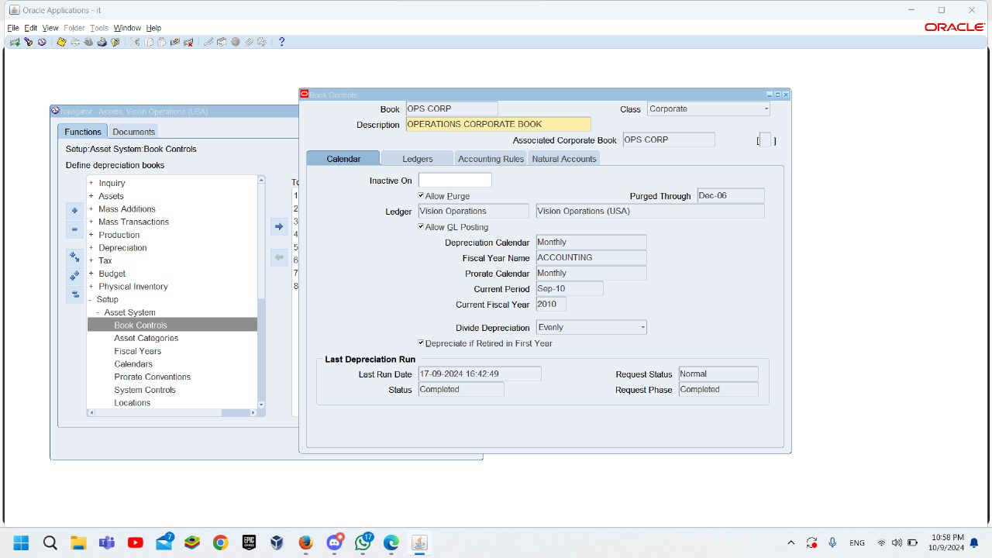
Book Controls SETUP<<ASSET SYSTEM <<Book Controls
Book Controls window shows:
Calendar, ledger, Accounting rules, Natural Accounts and their Information

Slide 14
3 ways to add asset
ADDITION
QUICK ADDITION
MASS ADDITION

Slide 15
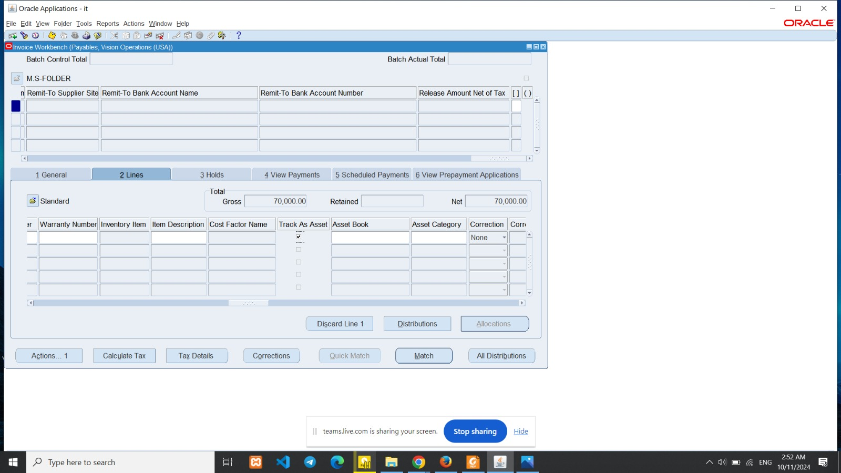
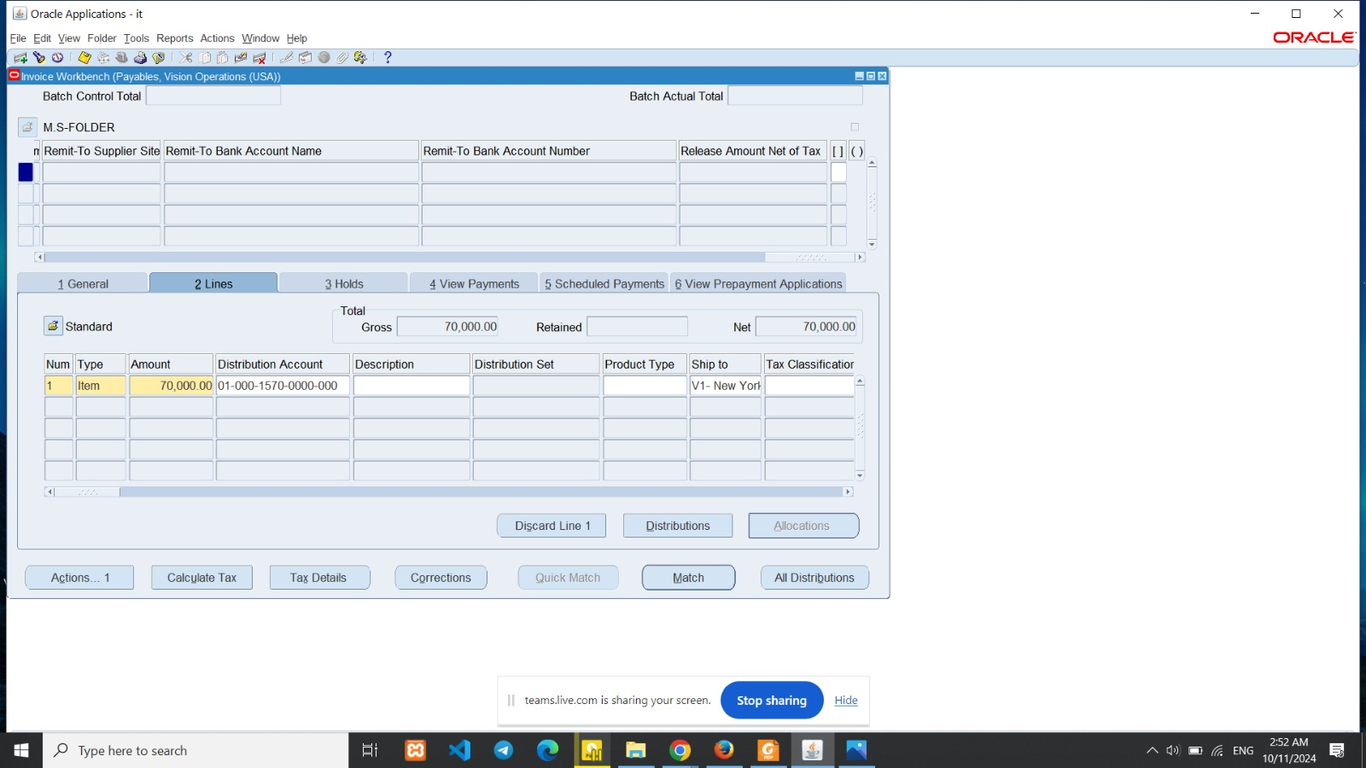
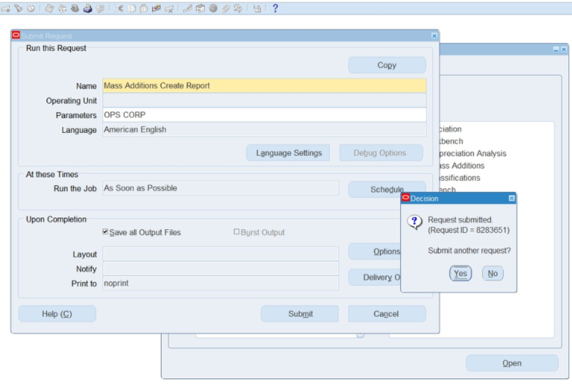
Mass Additions :
A . when creating an invoice in AP, you must choose the asset clearing account in distribution account.
b. Flag the checkbox of Track as an asset.
c. Action>>Validate>>create account.
d. Request>> Mass Addition Create Report.

Slide 16
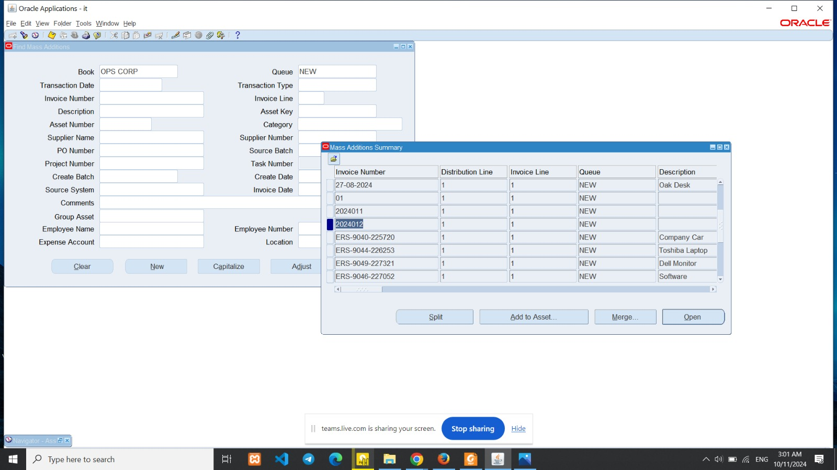
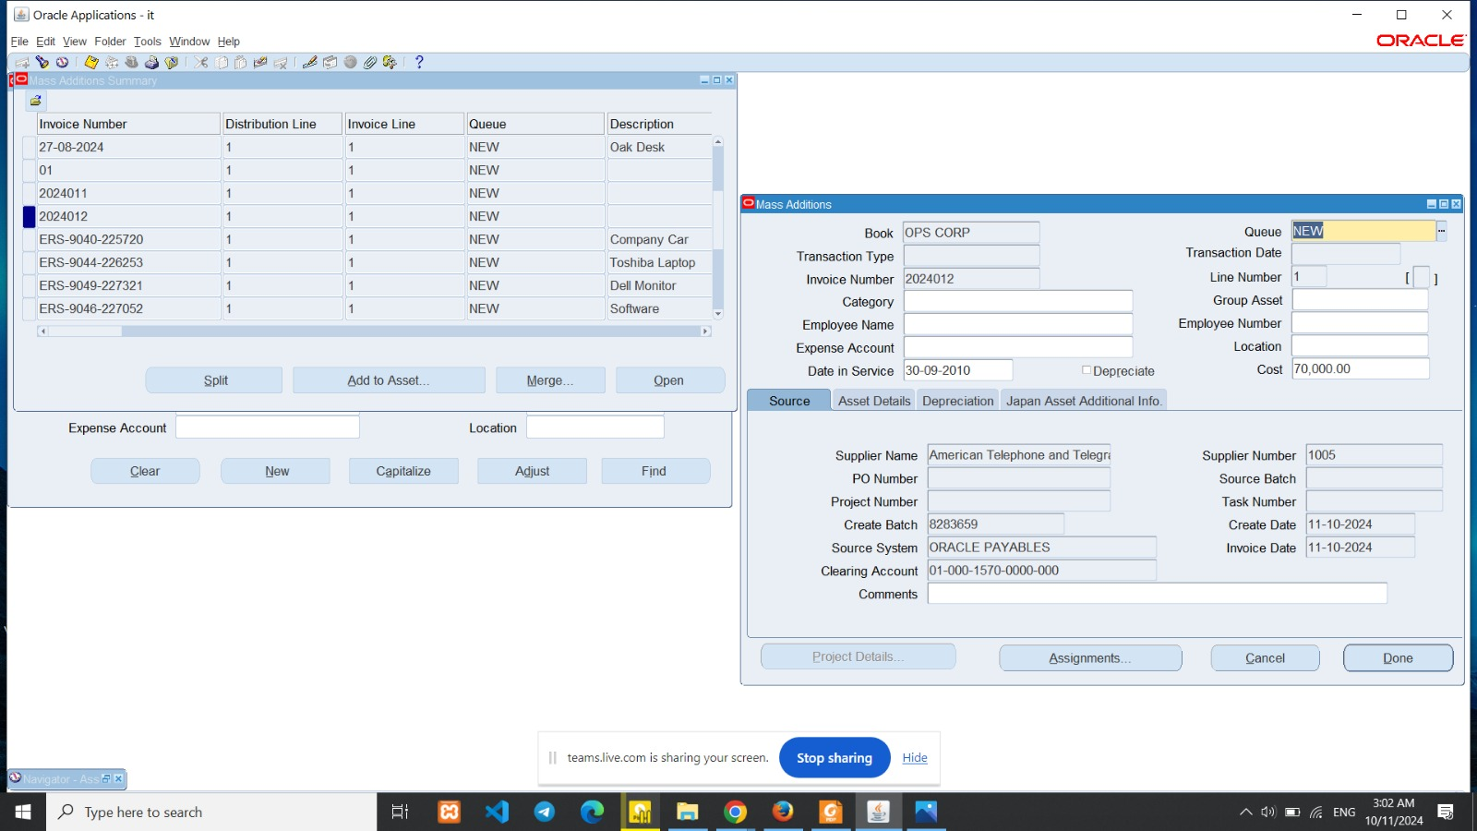
Prepare mass addition
Mass Additions>>Prepare Mass Additions

Slide 17
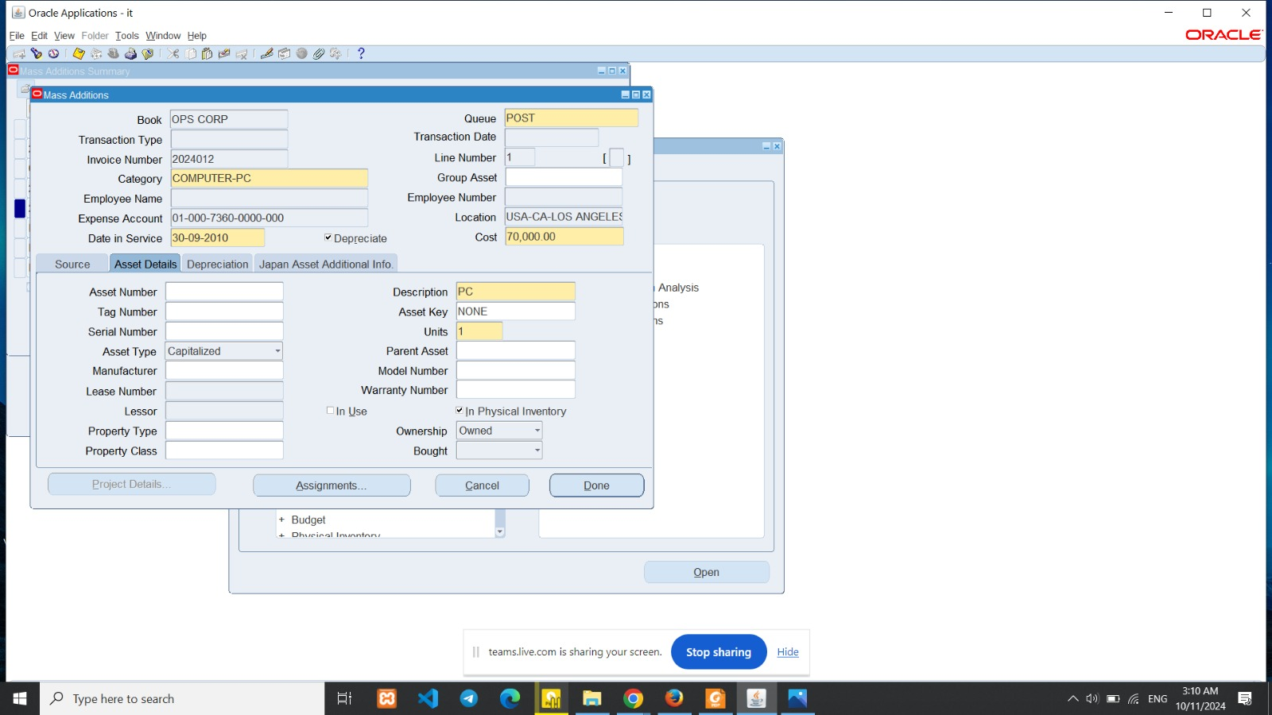
Change the queue from new to post << Done button.

Slide 18
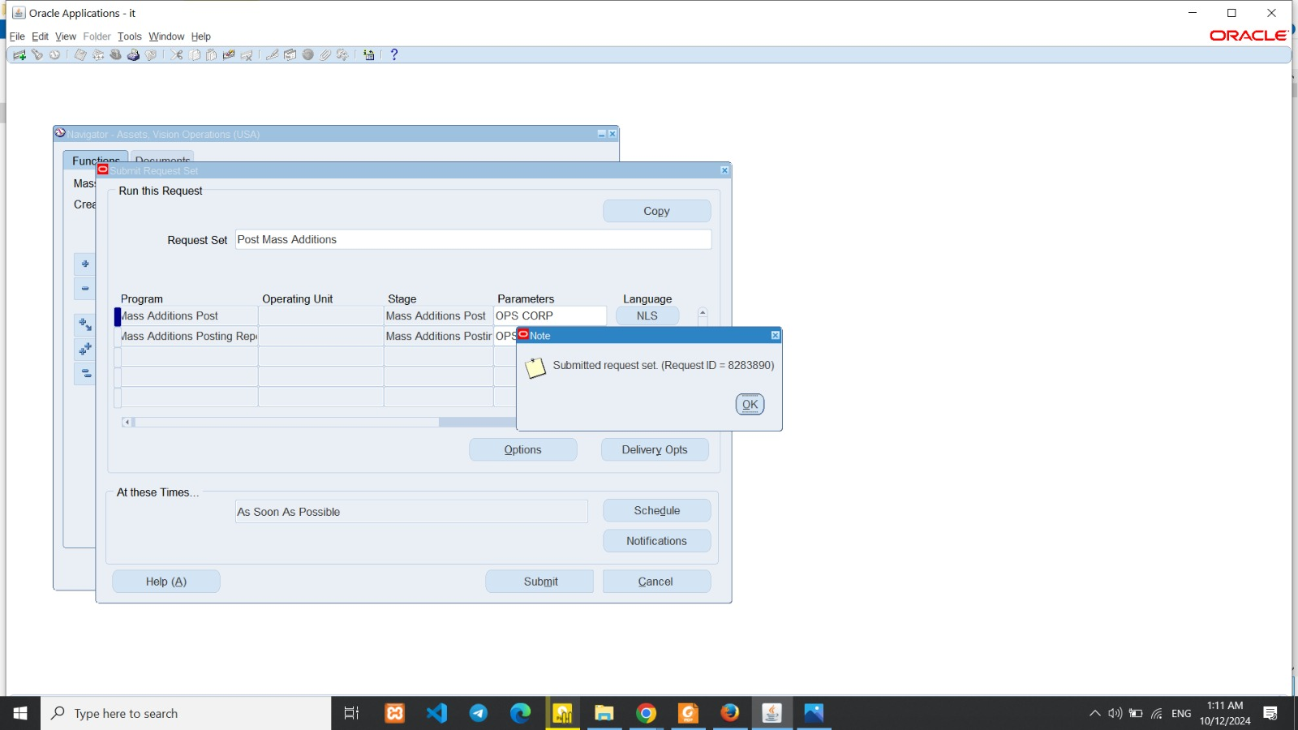
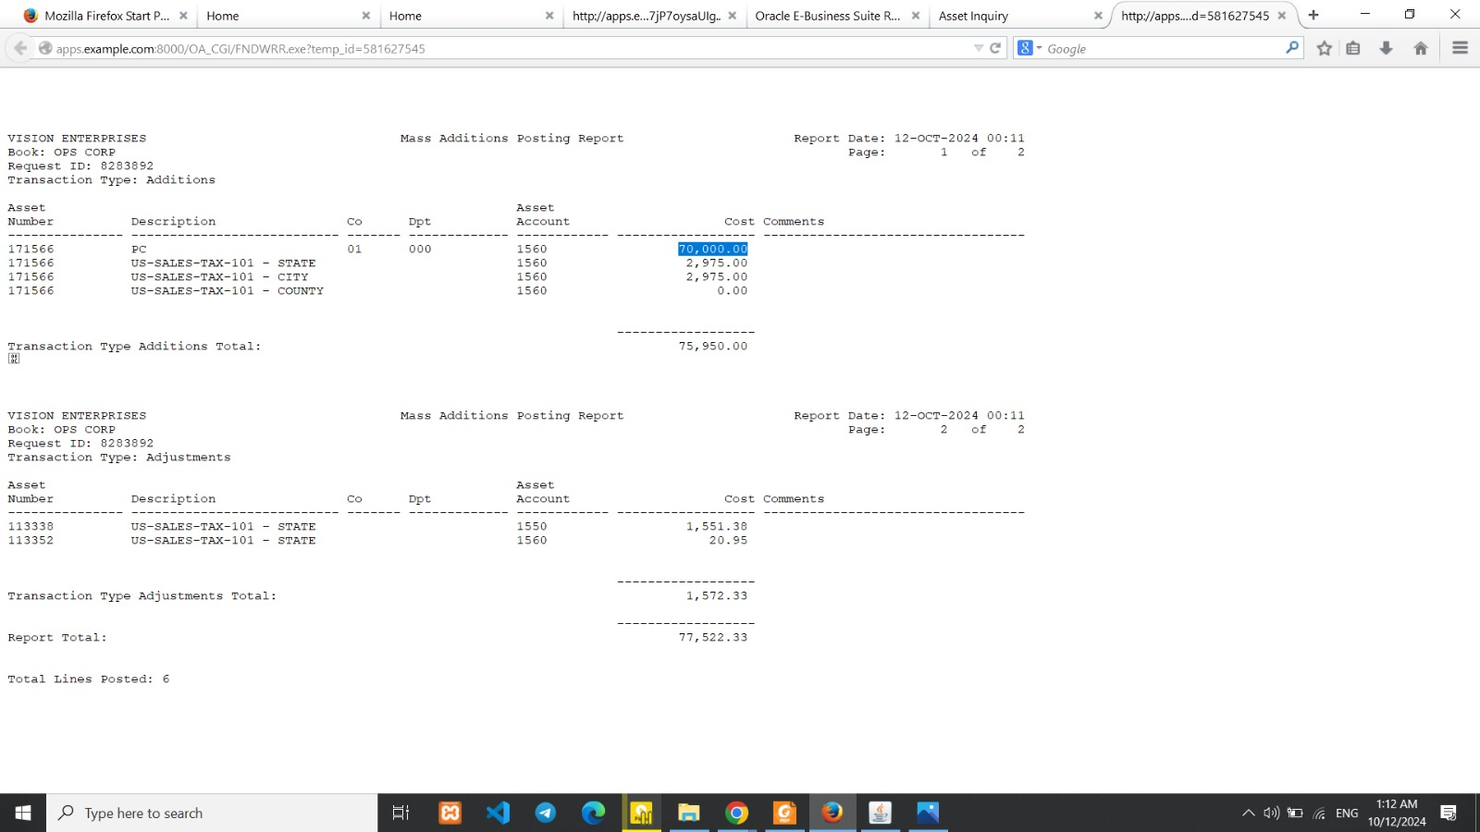
Post mass addition
Mass addition <<Post mass addition Parameters <<Book (asset book)<< submit
View<<Request<<Find<<post mass addition request<<view Output

Slide 19
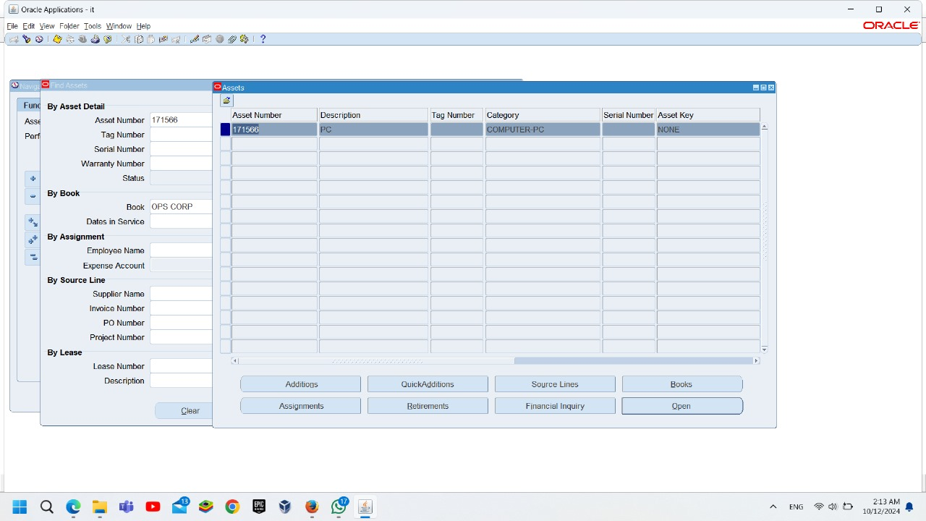
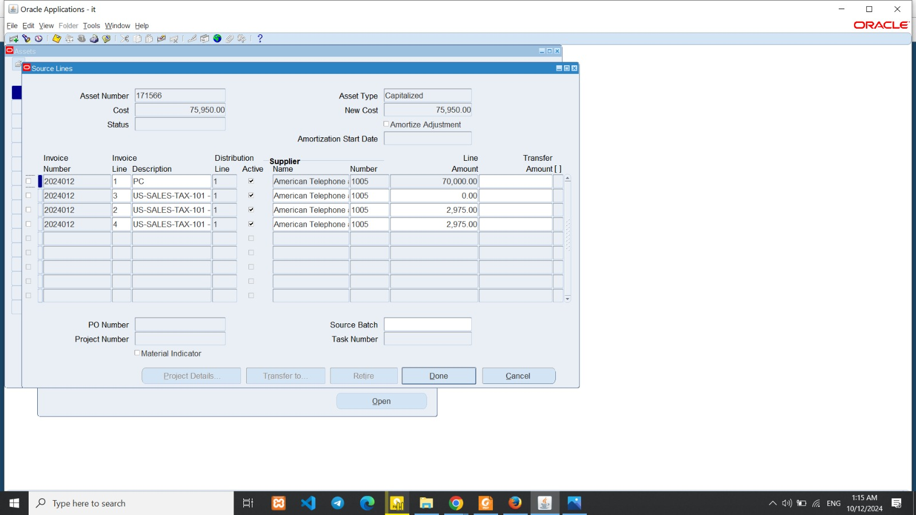
To ensure that asset is added
Assets<<Assets workbench<<Find assets Assets number 1715166 , Book ops corp

Slide 20
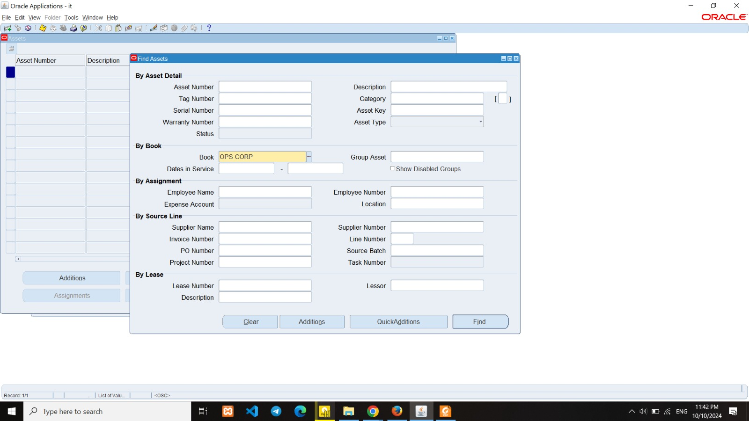
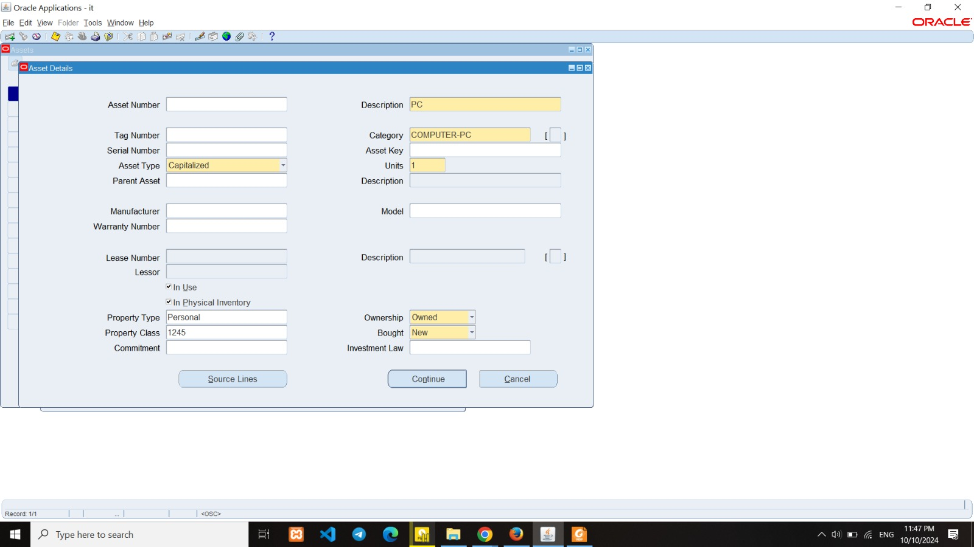
Asset Additions
1.Additions
Assets <<Workbench << Additions
Add
1-Asset type, description, category, and units.

Slide 21
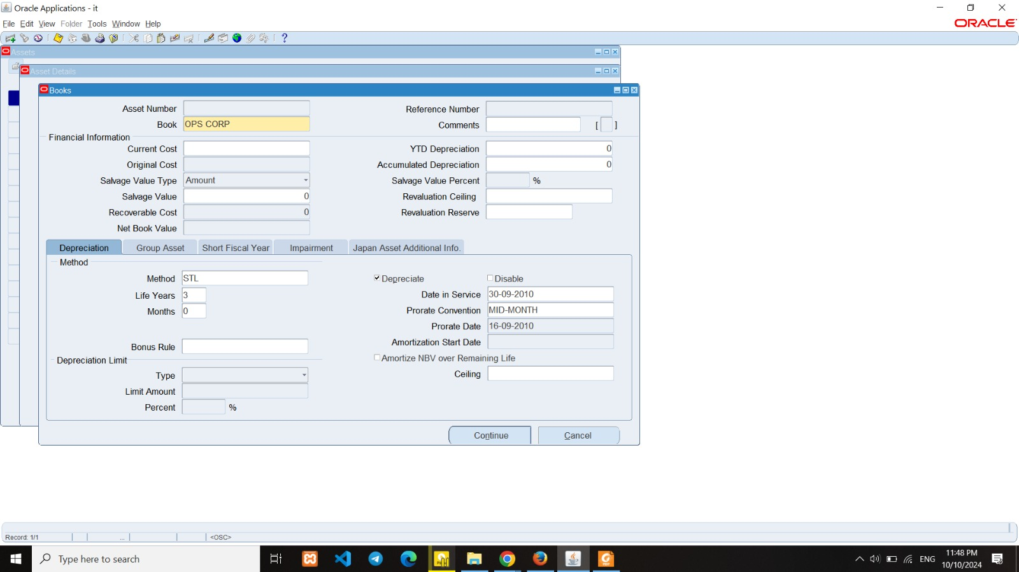

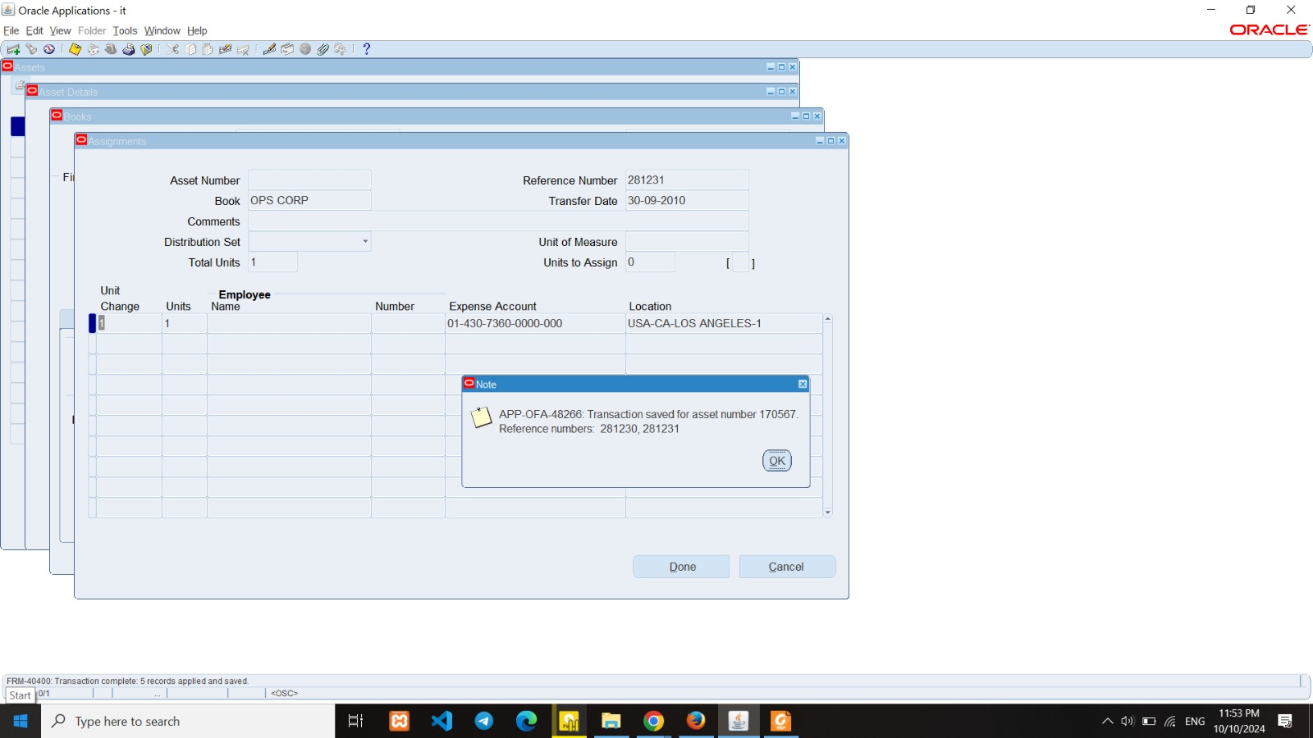
1-book name.
2-Current cost 3-Depreciation Method 4-life years 5-prorate date 6-Date in service
to add : Expense account and location

Slide 22
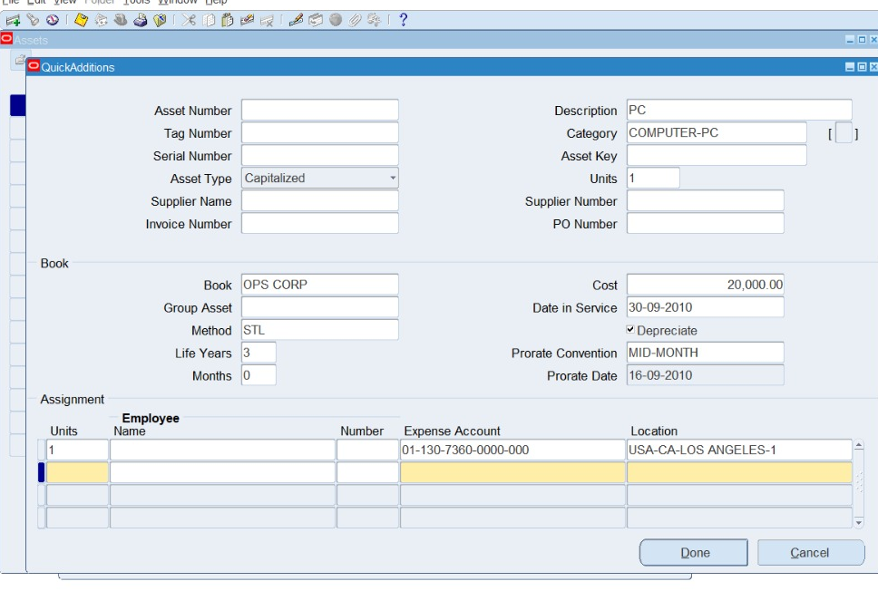
2-Quick Additions :
Assets -Workbench - Quick Additions

Slide 23
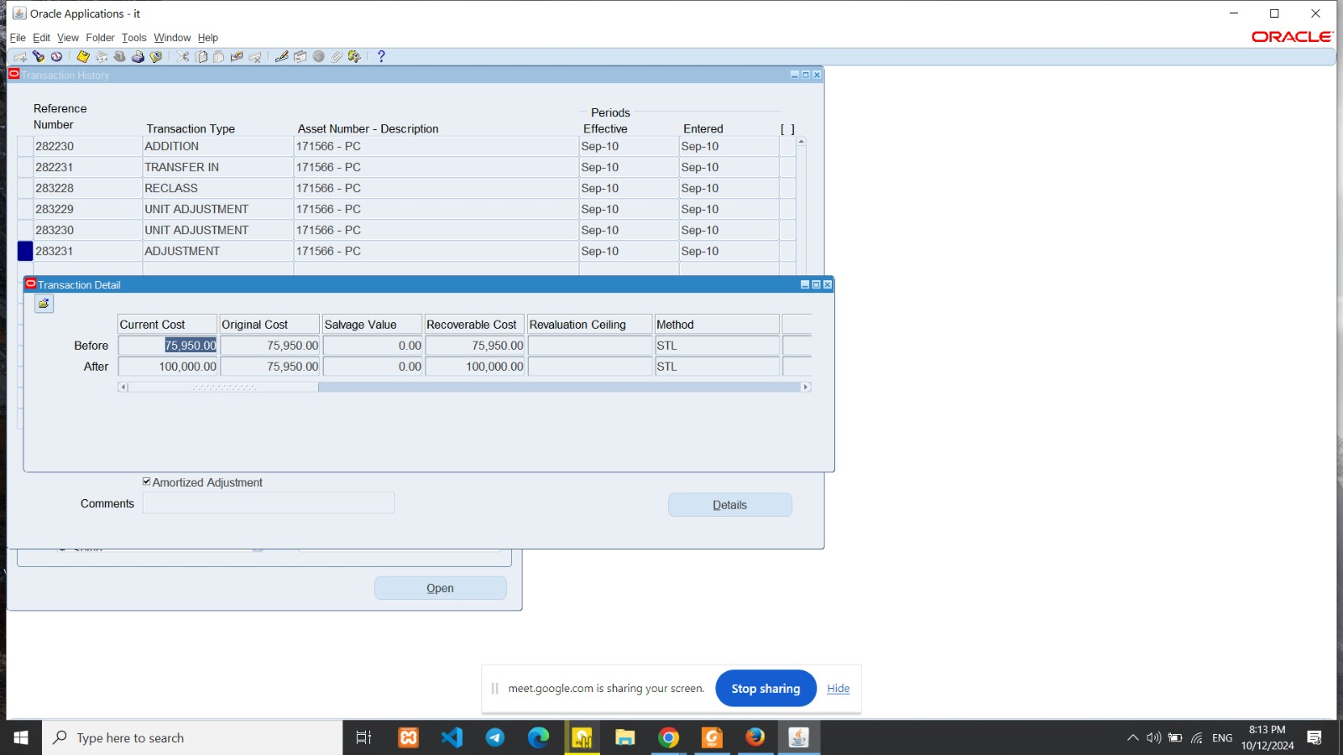
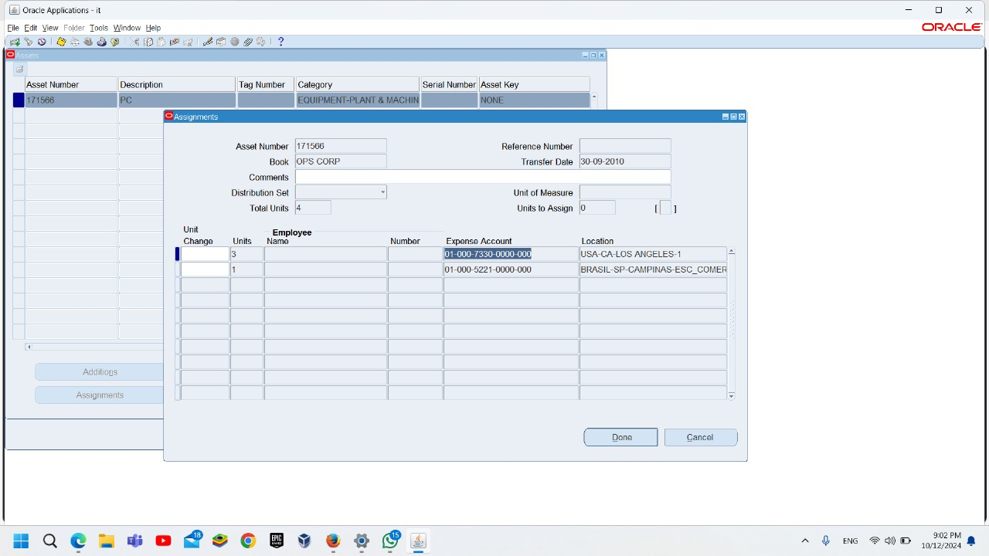
Asset Adjustment
Type Adjustment :
1- Reclass Category
2- Unit Change
(Assets workbench<< open)
3- Financial Information’s
(Assets workbench<< book)
4-Transfer Locations
5- Change Expense Account
(Assets workbench<< Assignment)

Slide 24
Inquiry:
Financial information
Transaction history

Slide 25
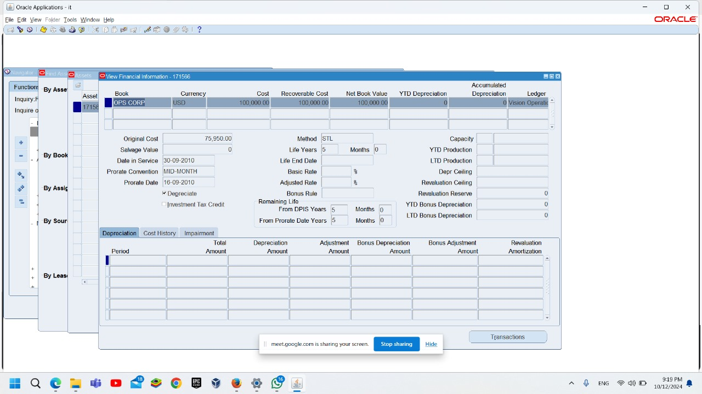
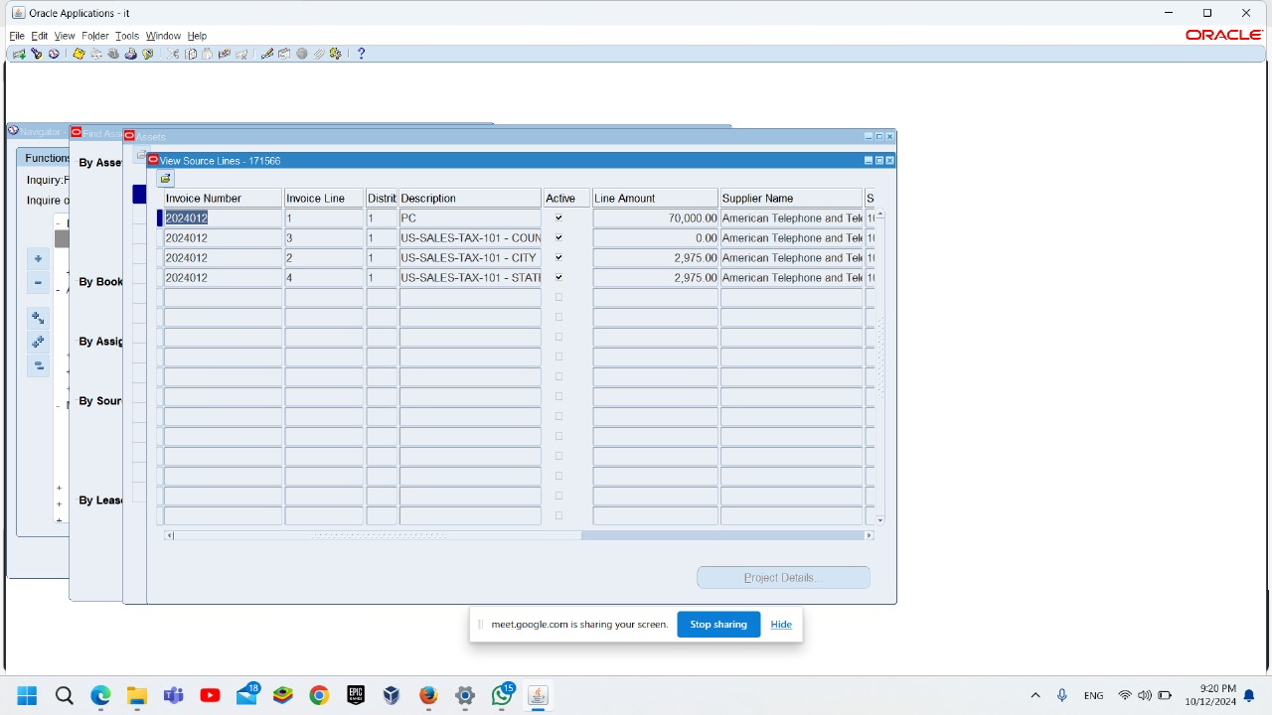
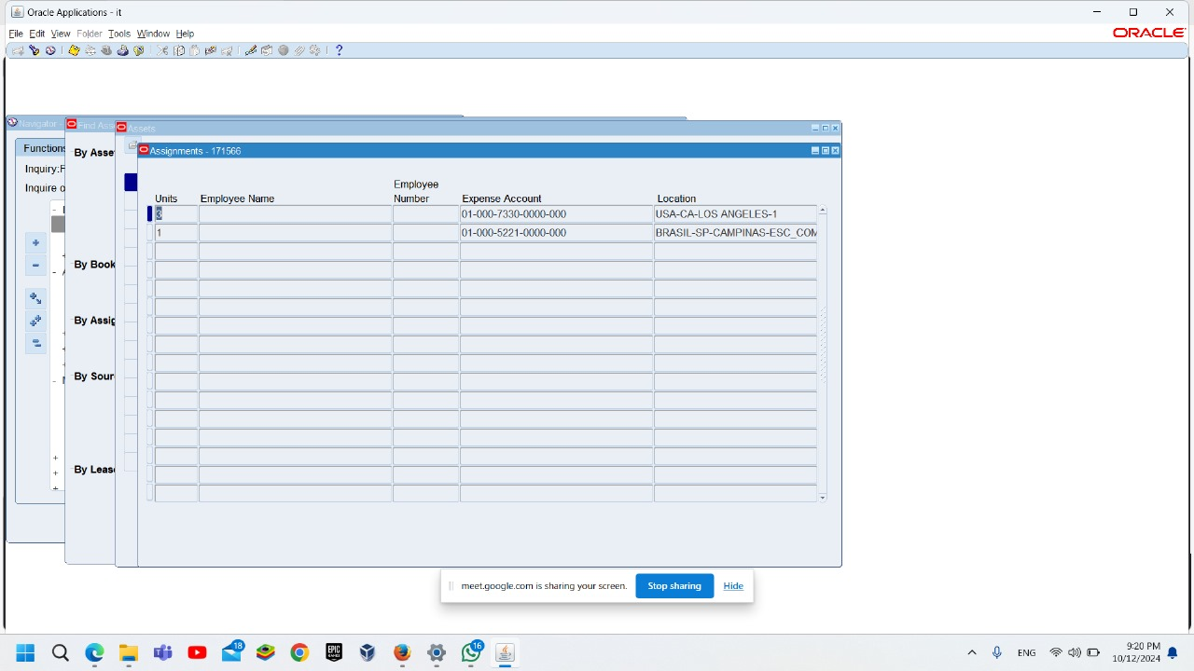
Assets Financial Information Book-source line -assignment
Inquiry<<Financial Information
Book: Show Financial Information of assets .
Source Line : Show Invoice Number and Supplier Name.
Assignment : Expense Account and Locations.

Slide 26
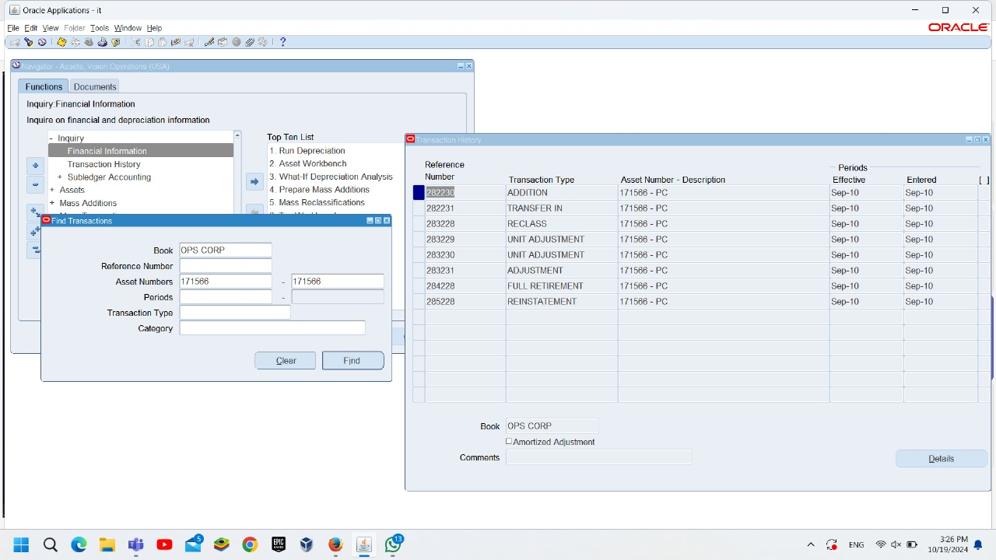
Transaction History
Show modified transaction :

Slide 27
Mass transactions
Transfers
Revaluations
Changes

Slide 28
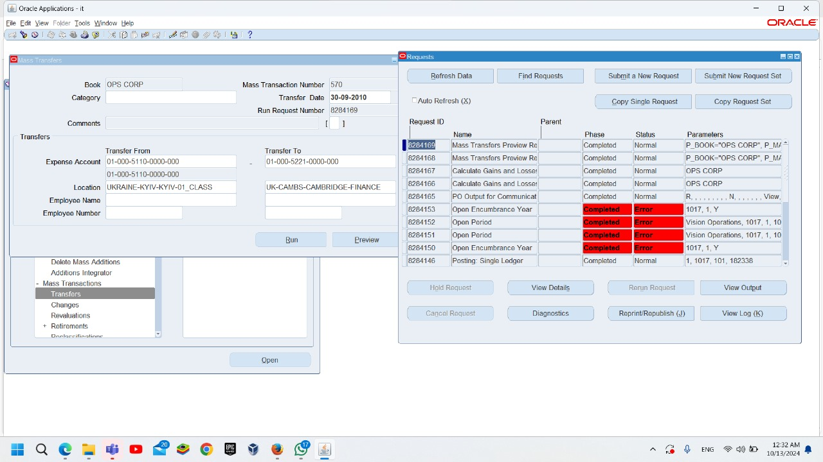
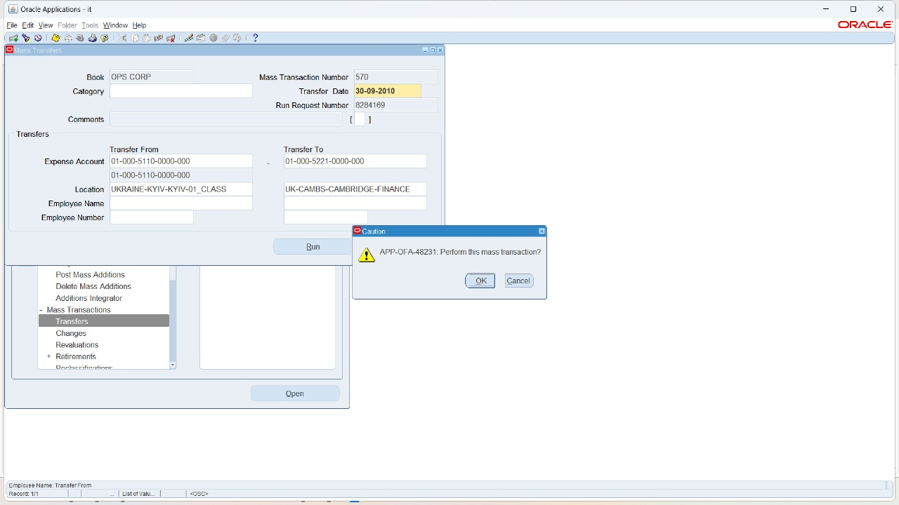
Transfer a GROUP of Assets between employees, expense accounts, and locations
Mass transfer:
Mass Transactions >> Transfers >>preview>>Run
To Find Request: View>>request>>Find>>choose our request>>view output

Slide 29
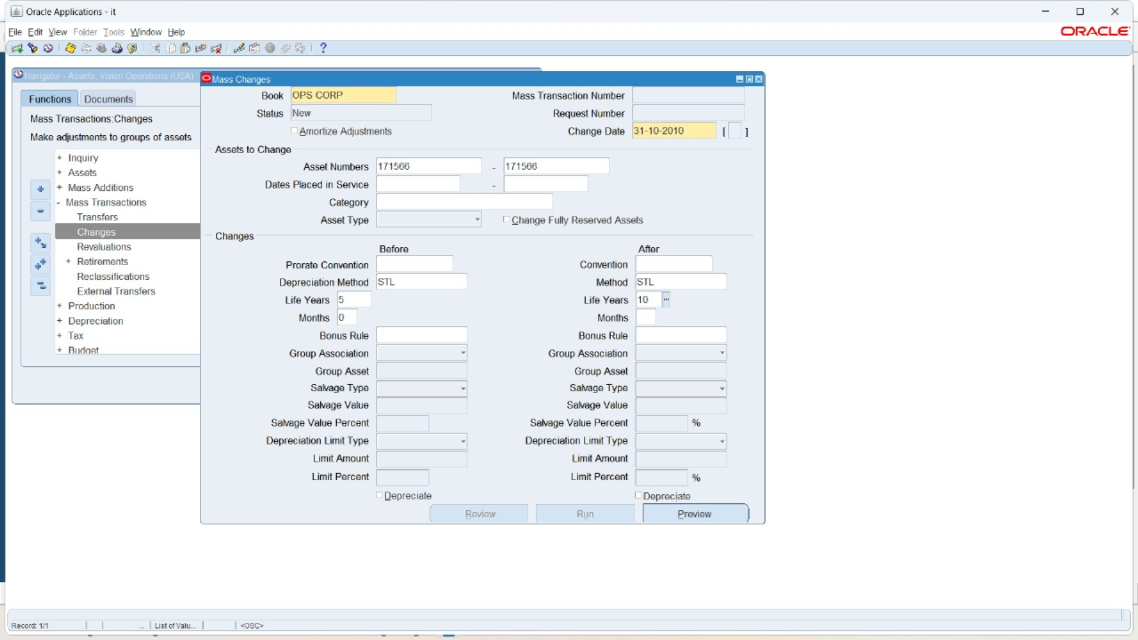
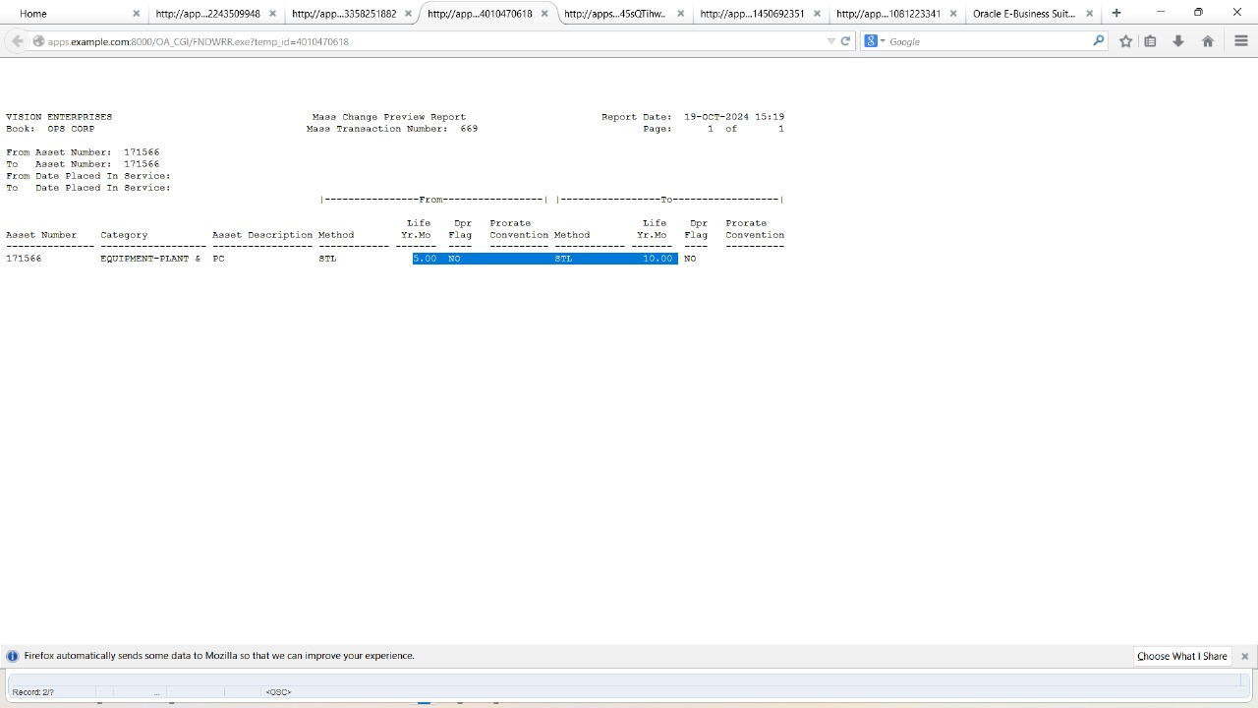
Mass changes
change information for an asset at any time other than category and units has no financial impact on the asset.
like: life years, depreciation method and prorate convention.
Mass Transactions>> Change
click on preview button
view >>request >>view out

Slide 30
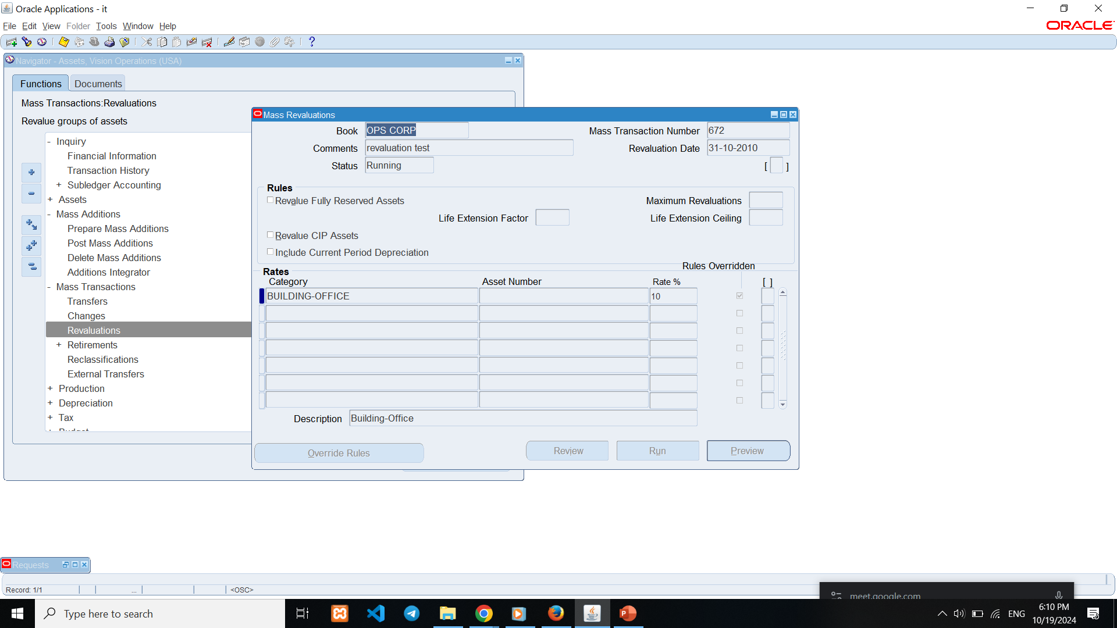
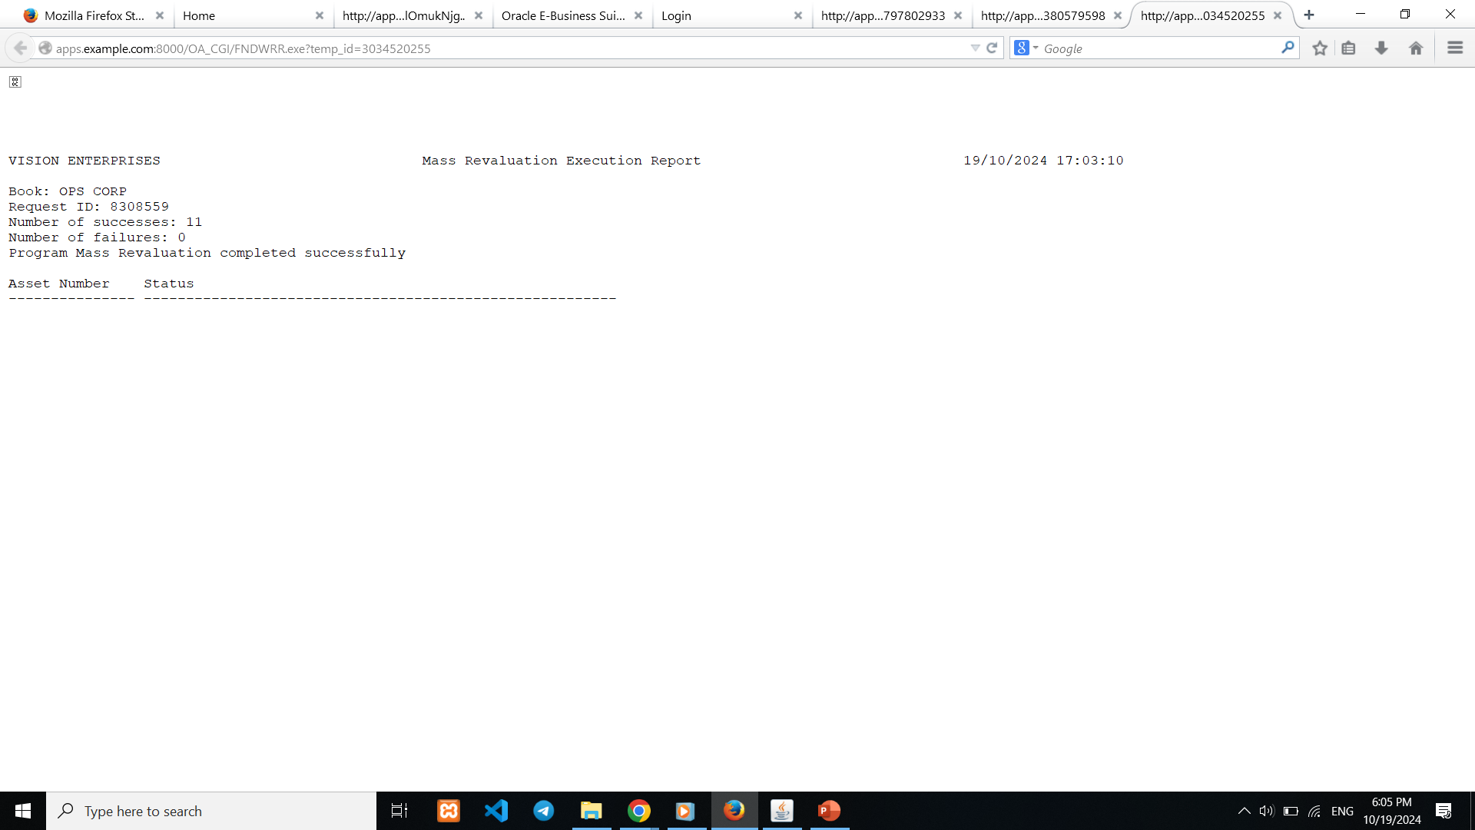
Mass revaluation:
Revalue assets to adjust the value of your capitalized assets in a highly inflationary economy.
You can revalue all categories in a book, all assets in a category, or individual assets.
Preview Revaluation >>Run Revaluation (Mass Revaluation Execution Report) Review Revaluation (Mass Revaluation Review Report )

Slide 31
Asset Retirement and Reinstate.
Retirement
Asset reinstate

Slide 32
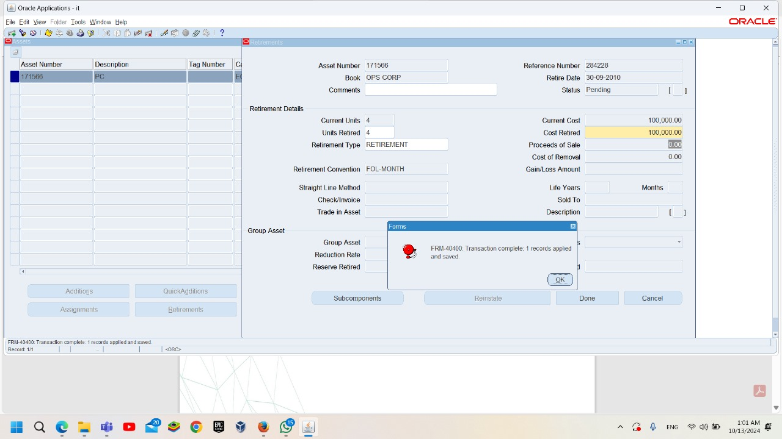
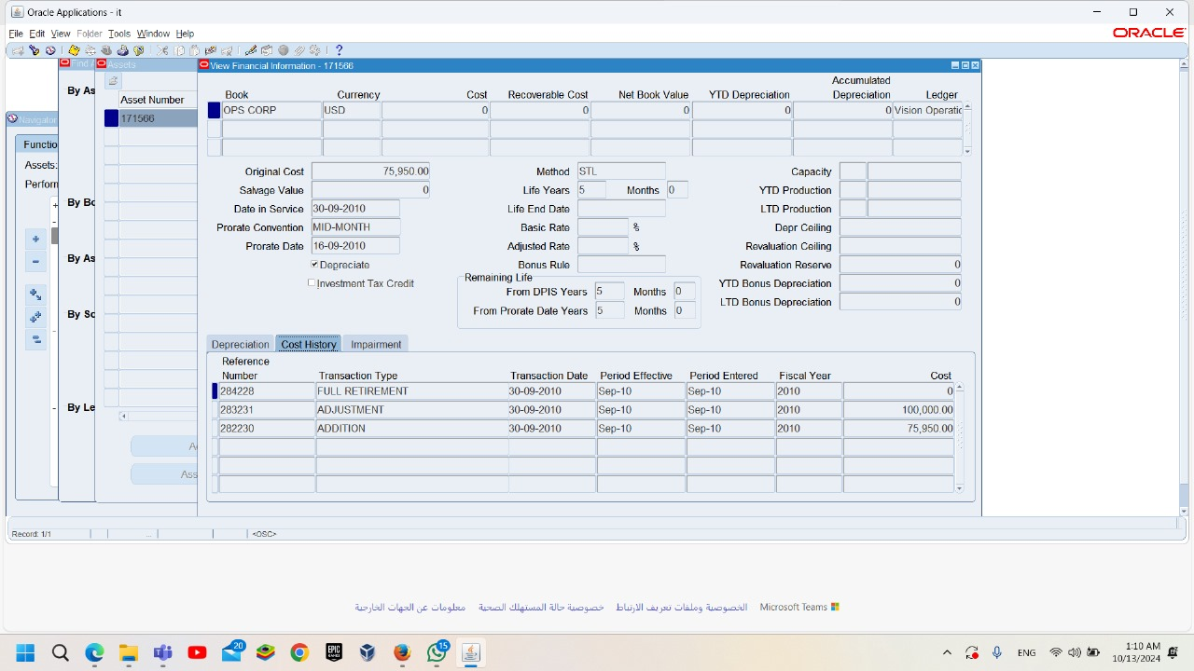
Retirement:
To ensure that the asset is retired :
Asset>>asset workbench>>to find assets>>financial information>>cost history.
There are 2 ways of Retirement First Way to Retire an Asset 1-Asset workbench >>Asset retirement. 2- Mass Retirement

Slide 33
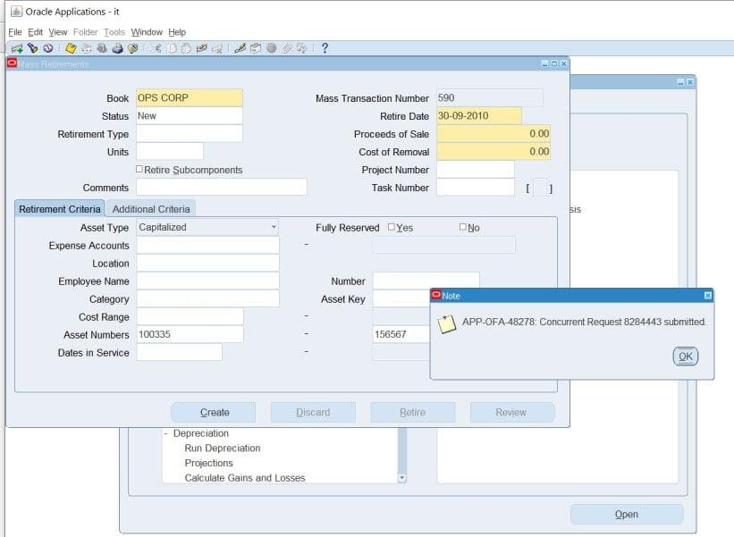
Mass Retirement:
Using Mass Retirements to retire a Group of Assets Mass transactions <> Retirements << Create and Reinstate Create button<<Menu << View << Requests<< View Output
After the Retirement, run Calculate Gains and Losses program
When you perform a mass retirement, Oracle Assets creates PENDING transactions that are not PROCESSED until you run the Calculate Gains and Losses program

Slide 34
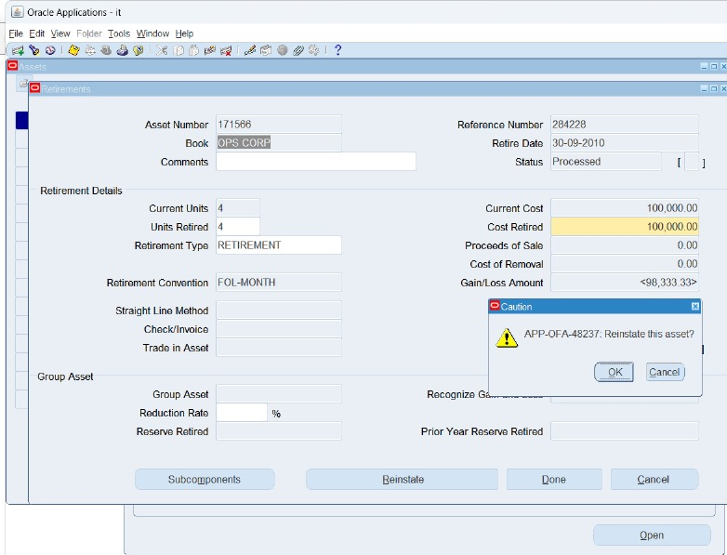
Reinstate assets :
Assets><Asset Workbench<<find asset<< Retirement<<Book<<Reinstate
Query the retirement transaction you want to undo If it is PENDING and the period is open choose Undo Retirement
If the retirement has a status of PROCESSED and the period is close choose Reinstate.

Slide 35
Final Asset Reports & closing Report.
Asset Register
Depreciation Report
journal entry reserve report
Calculate Gain/Loss Report for retired assets.

Slide 36
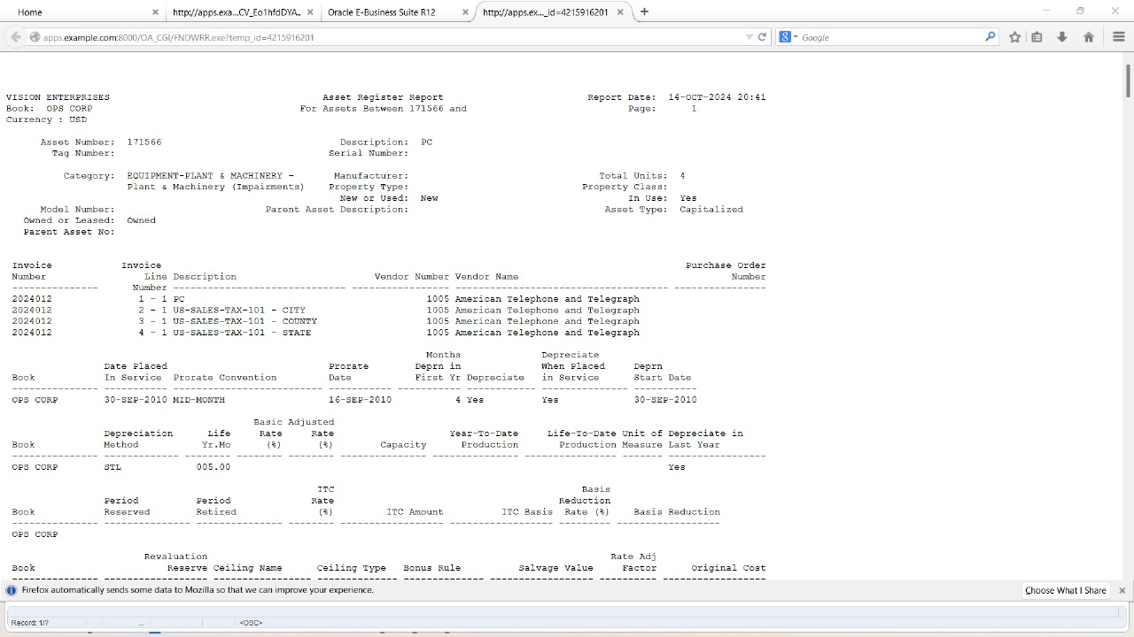
Asset Register Report:
show asset details like; Asset number – category –depreciation -
Asset type – Invoice number.

Slide 37
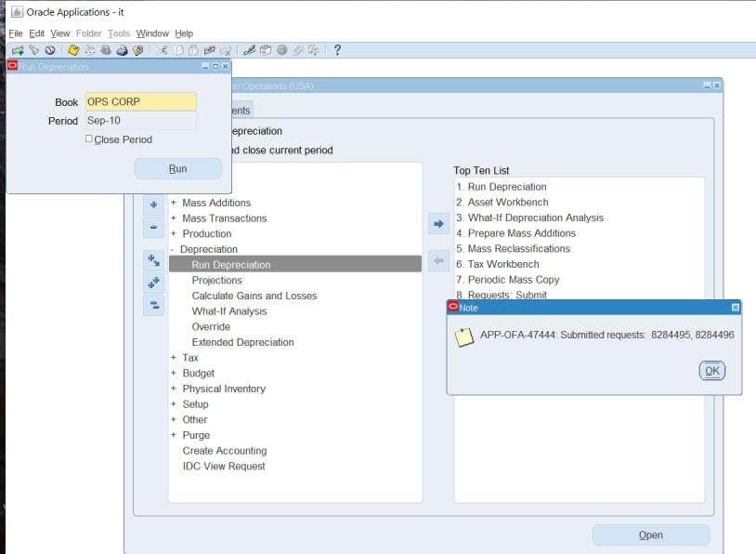
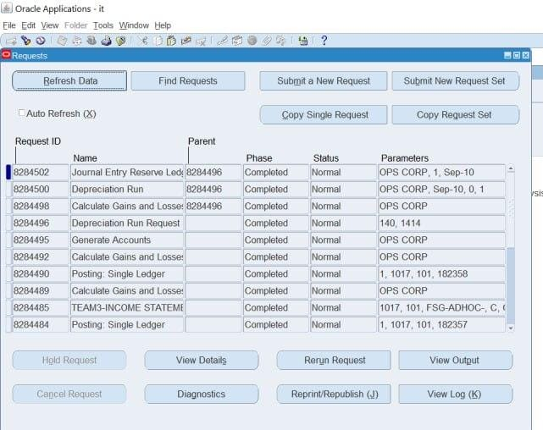
Depreciation Depreciation >> Run Depreciation
There are 3 reports due to run deprecation :
calculate gains and losses.
Depreciation.
Journal entry reserve ledger.

Slide 38
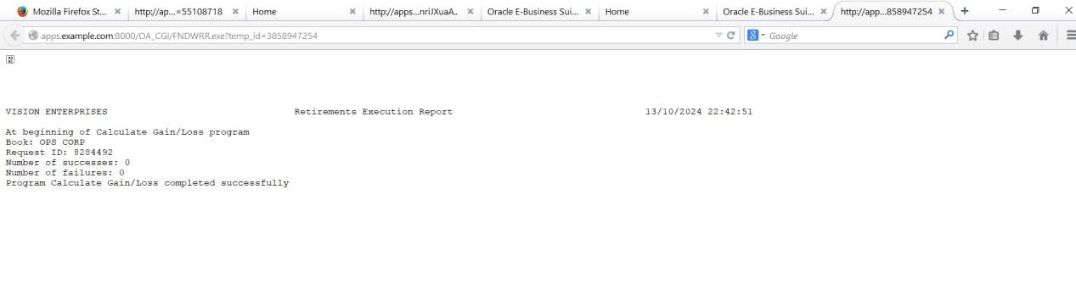
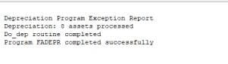
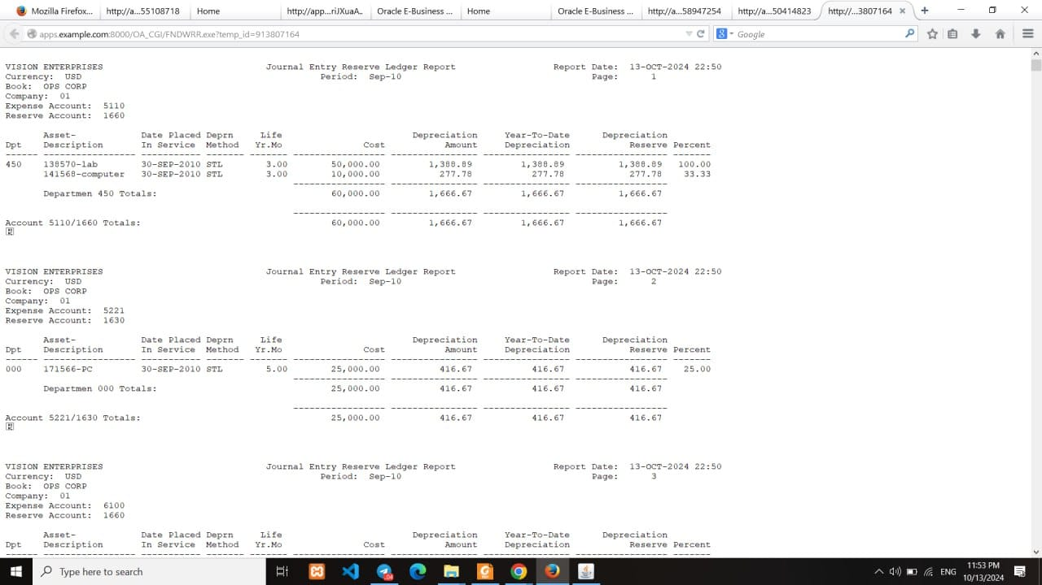
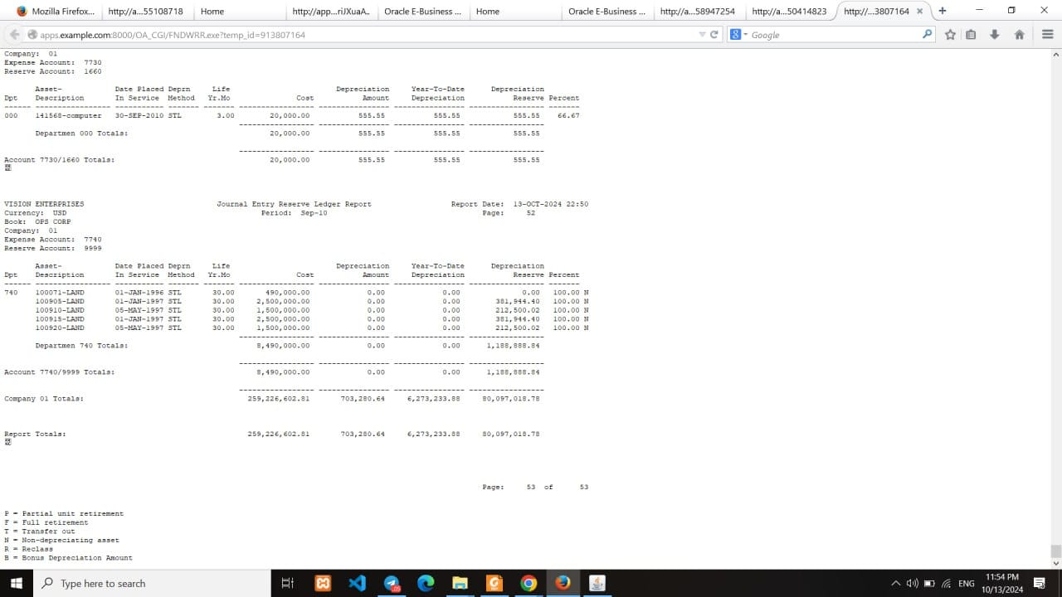
Show the output report
Calculate Gain and loss request >>View Output
Run Depreciation request>> view output
Journal Entry reserve request >> view output

Slide 39
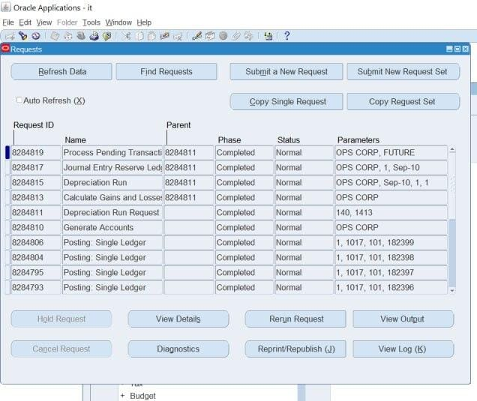
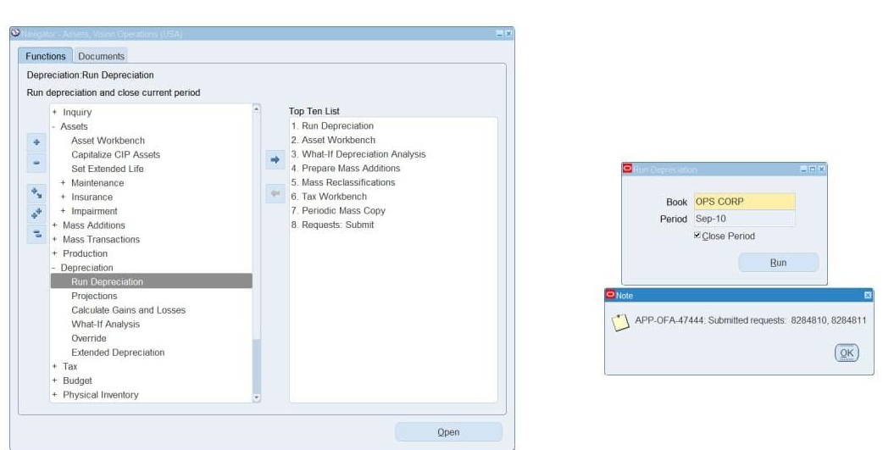
Closing a Depreciation Period
When you run depreciation, Oracle Assets gives you the option of closing the current period if you check the Close Period check box on the Run Depreciation window. If all of your assets depreciate successfully, Oracle Assets automatically closes the period and opens the next period for the book.

Slide 40
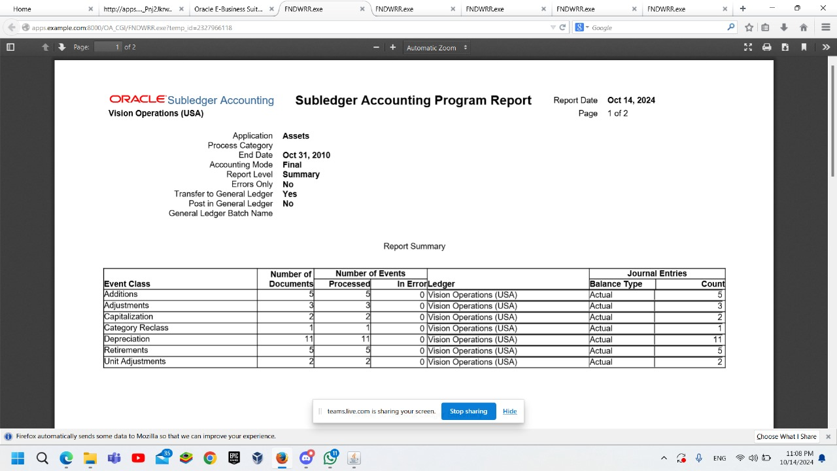

Reconcile the Fixed Assets ledger with the General Ledger.
The Create Accounting- Assets concurrent program creates journal entries for transaction events in Oracle Assets. The journal entries can be transferred to and posted in the General Ledger.
View>>request>>submit a new request>>create accounting.
Navigator>>create accounting.

